Slide 1
Digital Communication Project

Slide 2
Part 1: ISI due to band-limited Channels

Slide 3
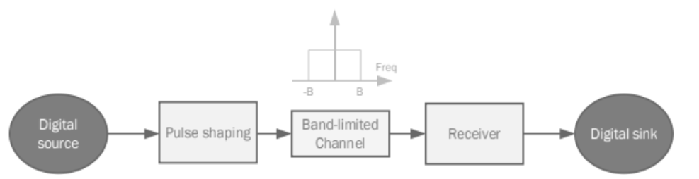
Part 1: ISI due to band-limited Channels

Slide 4
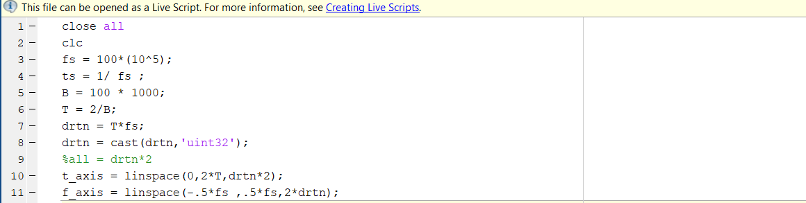
Defining variable

Slide 5
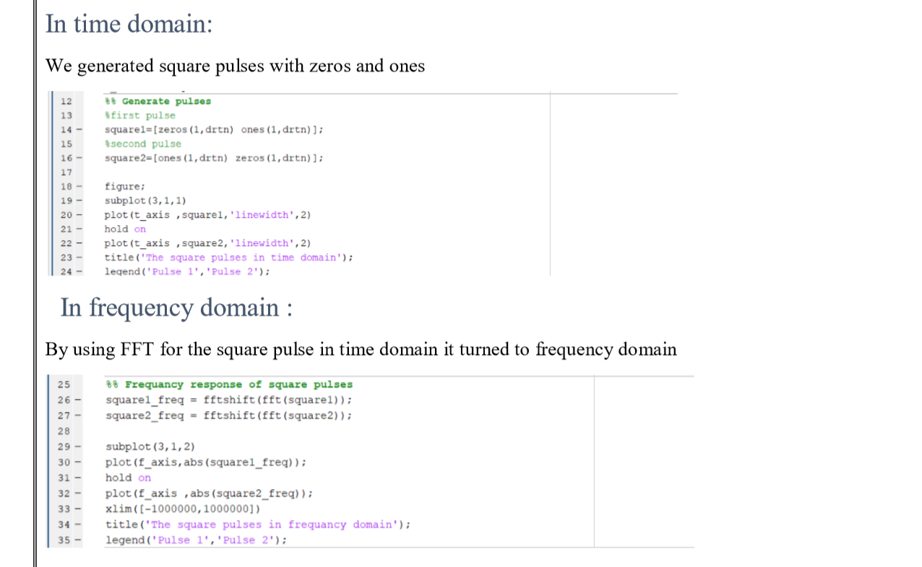
To generate square pulses

Slide 6
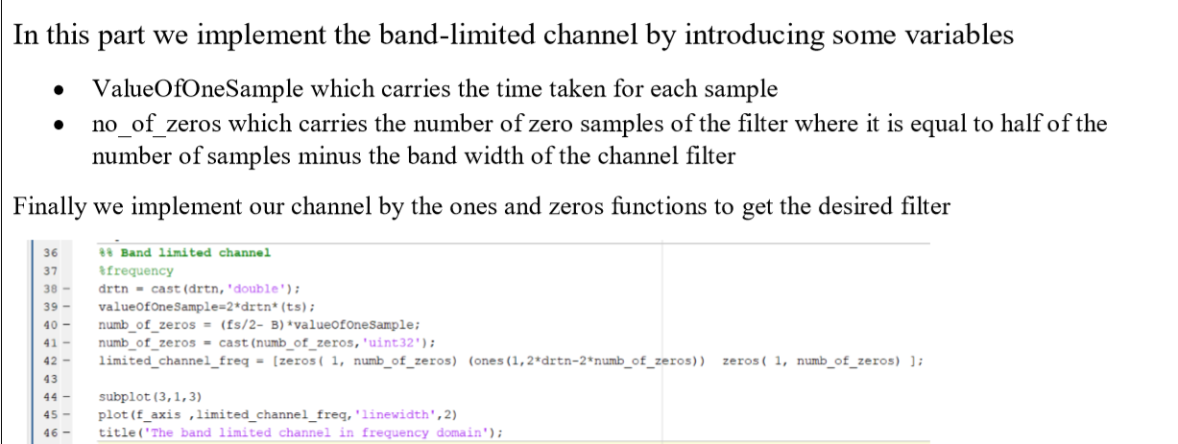
Generating the band limited channel

Slide 7
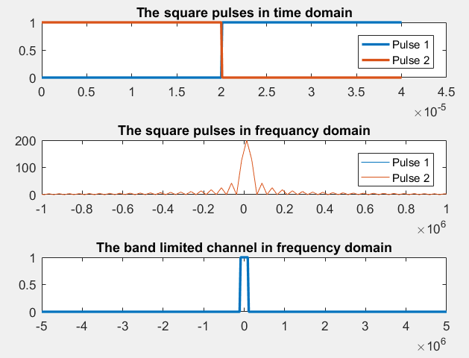
Pulse shaping and channel

Slide 8
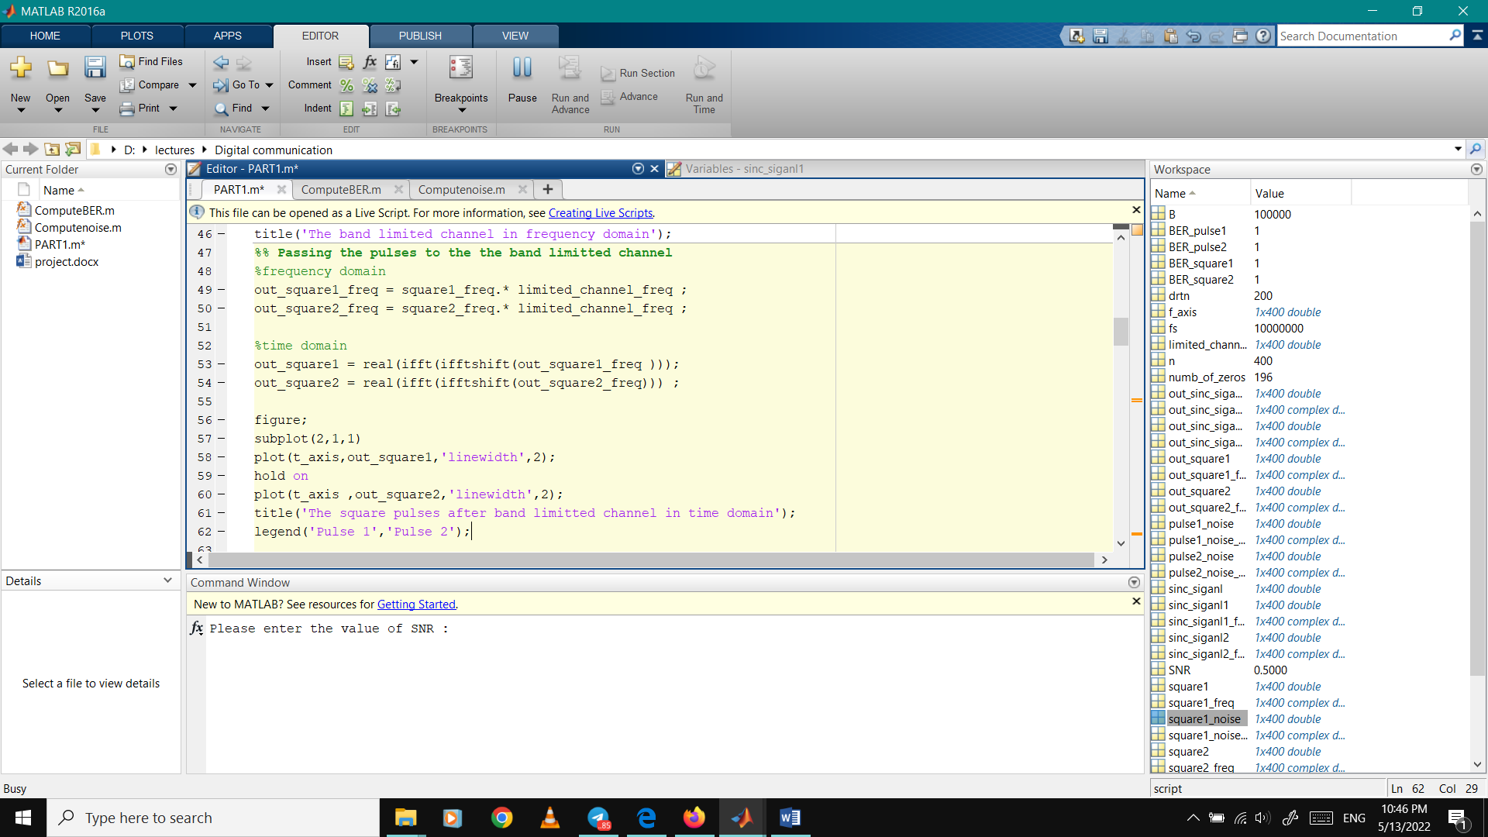
Passing pulses through band channel

Slide 9
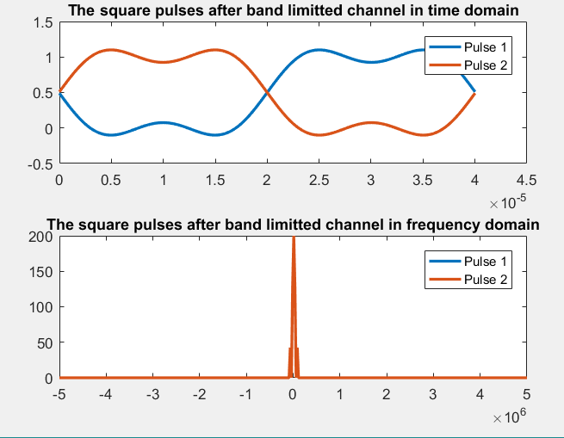
Effect of band-limited channel on the two square pulses

Slide 10
Effect of band-limited channel on the two square pulses
For nullifying the ISI terms, with an impulse of unit value applied at t=0 to the combined filters h(t) the samples of the h(t) at the output of the filter combination should be 1 at the sampling instant t=0 and zero at all other sampling instants kTb(k!=0) This is called Nyquist criterion for zero ISI.On the other hand, the signal that avoids ISI with the least amount of bandwidth is a sinc function that has zeros at t = Tb, 2Tb, 3Tb, … will also satisfy this condition.

Slide 11
Sinc pulse shaping
Raised-cosine pulse shaping
Square-root raised-cosine pulse shaping

Slide 12
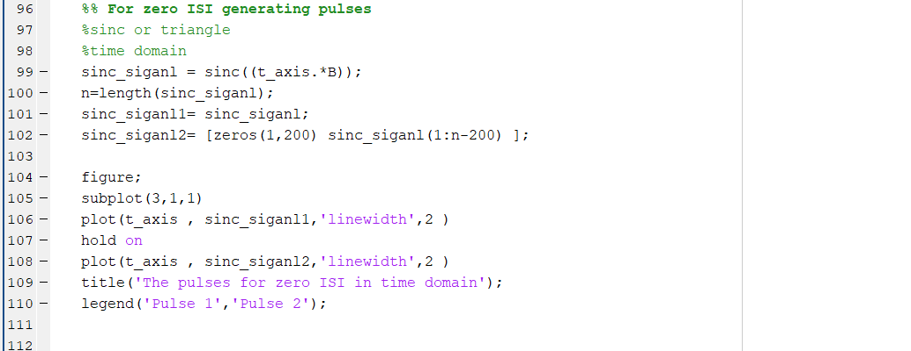
Generate sinc pulses

Slide 13
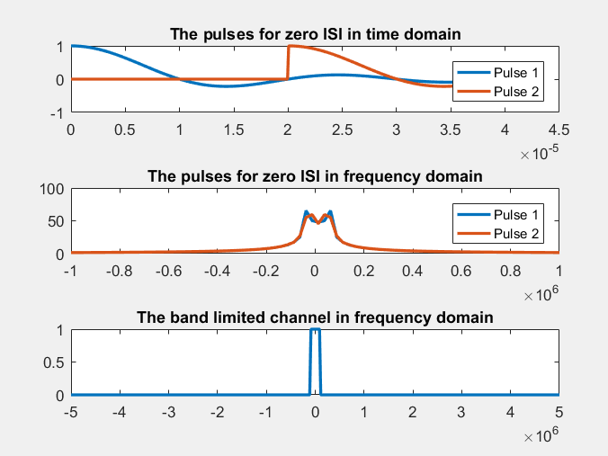
Sinc functions that ensures the criterion pulses of no ISI

Slide 14
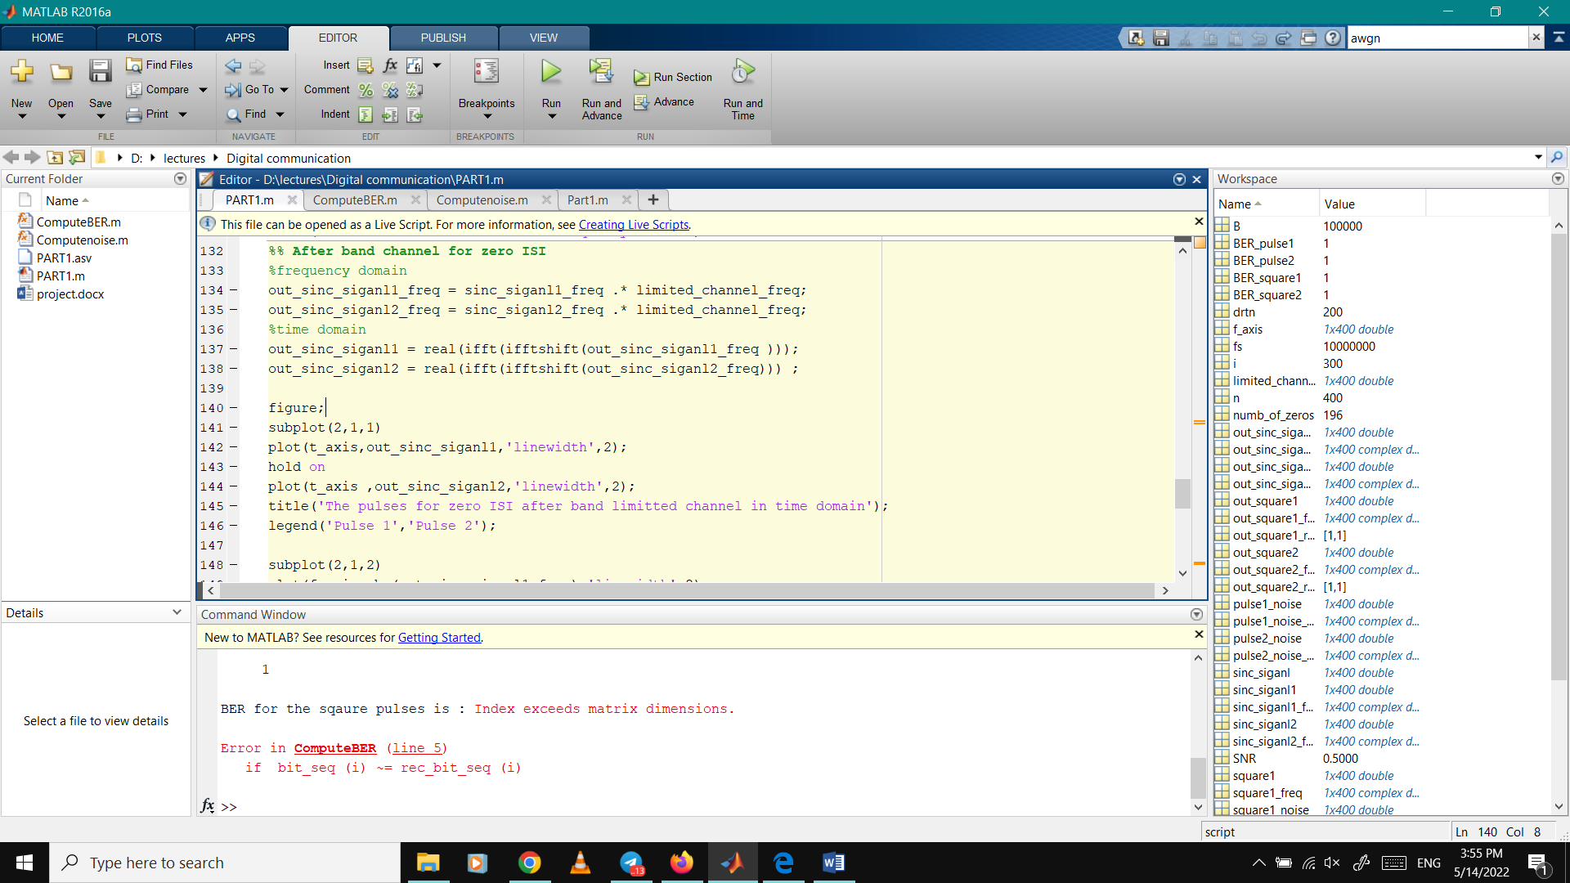
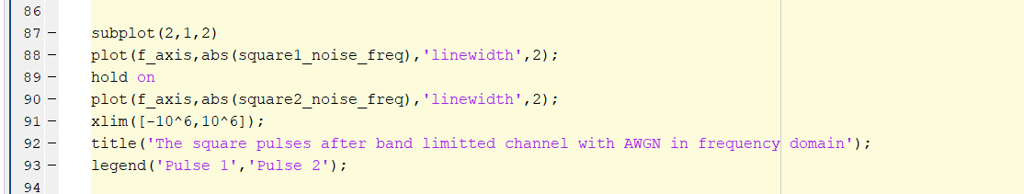
Passing through channel

Slide 15
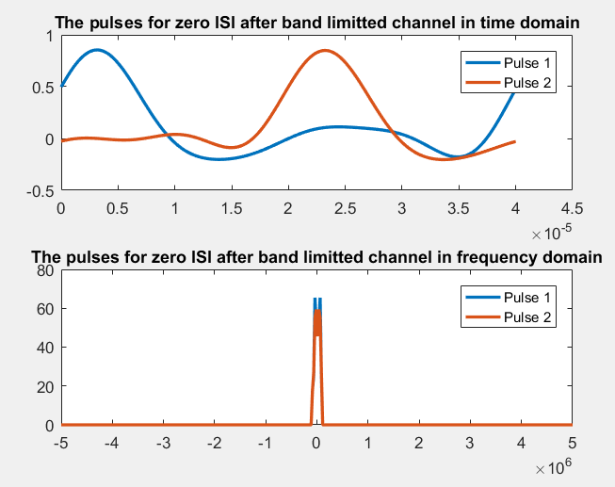
Effect of band-limited channel on the two sinc pulses pulses

Slide 16
Optional part

Slide 17
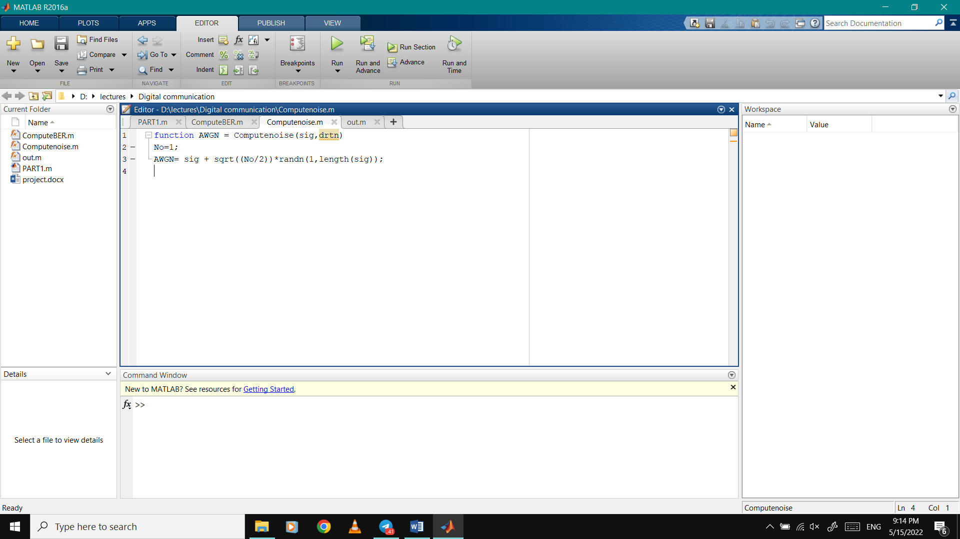
AWGN channel

Slide 18
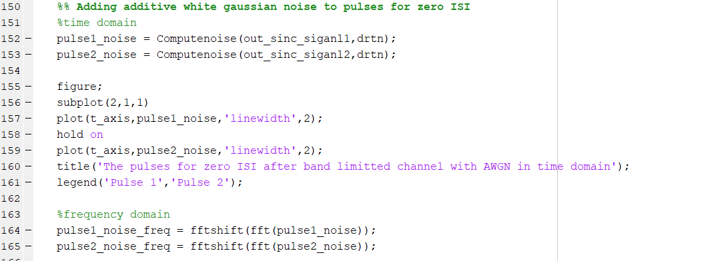
Adding noise to sinc

Slide 19
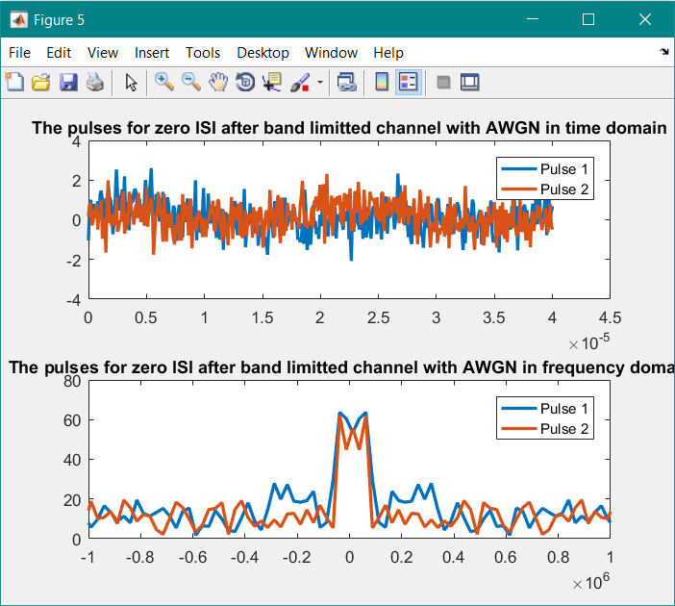

Slide 20
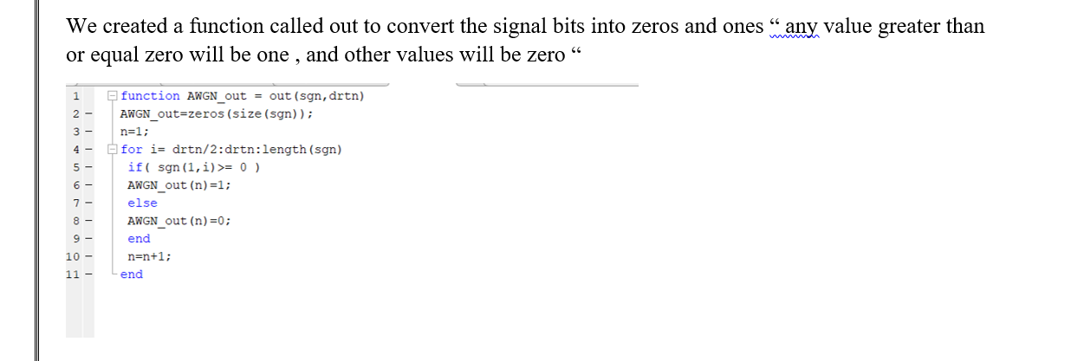
To compute BER :
first function “out”

Slide 21
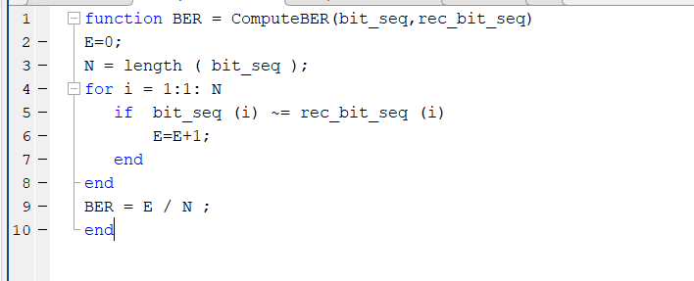
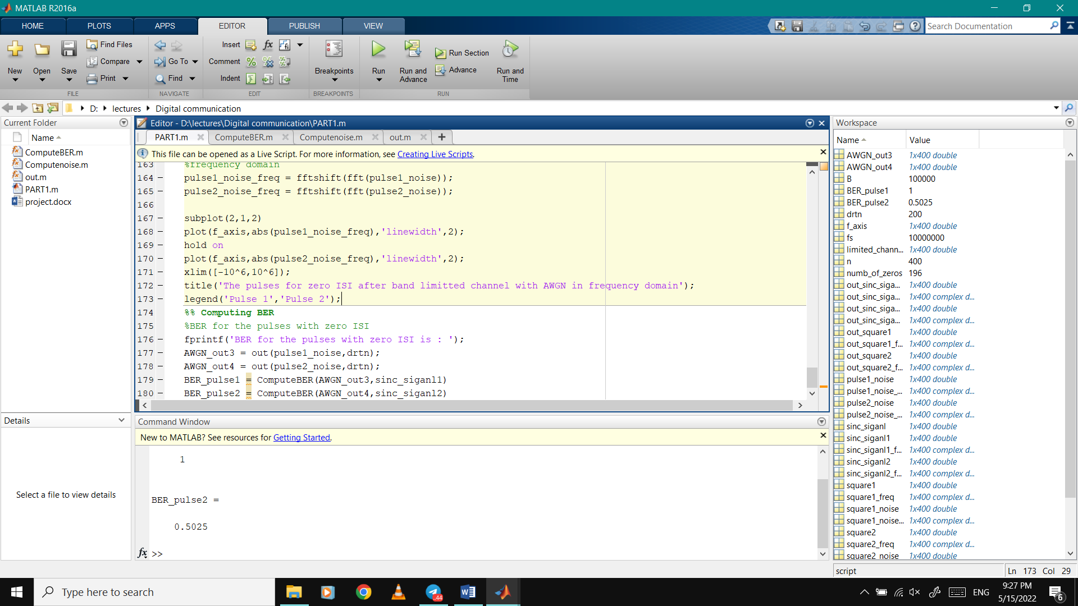
To compute BER :

Slide 22
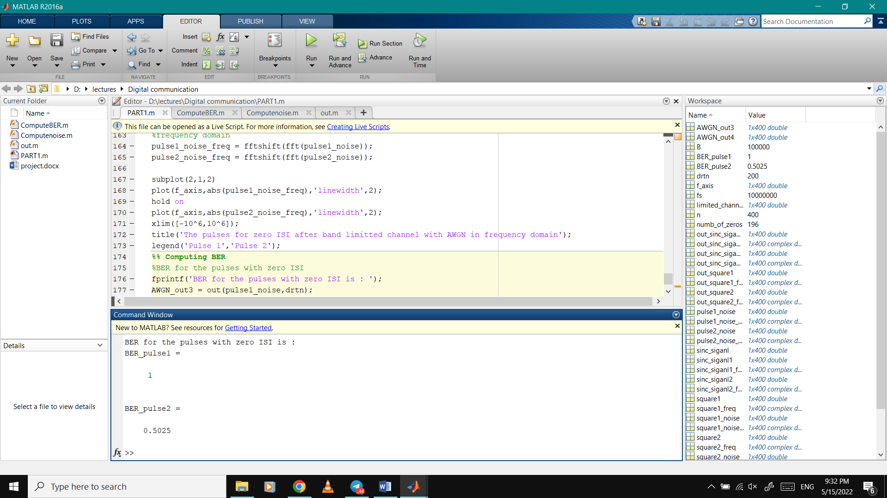
To compute BER :

